Slide 1

CIS 380W Final Presentation:
UAVs in Rural SAR Operations
Presented by:
Cadet Charles B. Malé
Cadet Stephen A. Ralis
Help Received: Presentation Template From Canvas

Slide 2
Agenda
Key Terms & Research Journey
Motivation & Problem
Background & related works
Model design & Implementation
Experiment & results discussion
CONCLUSION & FUTURE DIRECTION

Slide 3
Key Terms
UAV: Unmanned Aerial Vehicle
RAT: Radio Access Technology
MEC: Mobile Edge Computing
LBPH: Local Binary Pattern Histogram
VAS: Value Added Services
IoT: Internet of Things
FANET: Flying Ad Hoc Network
SO: System Orchestrator
GCS: Ground Control Station
LOS: Line of Sight

Slide 4
Research Journey
19 Nov. 2023
Finalized Research
24 Nov. 2023
Finalized UAV System
28 Nov. 2023
Integrated Image Recognition Software and Drone Camera
4 Dec. 2023
19 Dec. 2023
Finalization of Paper
16 Nov. 2023
Final Presentation/Project Demo
19 Oct. 2023
22 Oct. 2023
Start of UAV Use Case Research
Start of UAV System Research
Progress Check Point
Notes:
Finalize Background Research: 11/19/2023
Drone and Controlling System: 11/24/2023
Integrate Image Recognition Software and Drone Camera: 11/28/2023
Finalization of Paper: 12/3/2023
Final Exam/Project Presentation: 12/4/2023

Slide 5

Motivation
5/32
Over the past decade, commercial drones have seen large advancements in technological developments—leading to them becoming more accessible to the average consumer. Because of these advancements, there has been a rise in interest for the exploration of emerging use cases.
https://enterprise-insights.dji.com/learning-center/building-search-and-rescue-drone-program

Slide 6
Problem in a Nutshell
The problem with traditional SAR operations is that they are resource-heavy; often requiring numerous people on foot as well as aerial support via helicopter. Not only is this costly, but incredibly inefficient as members of SAR operational units that are on foot are limited in capability.
Lack of Human Resources
Lack of Capital Resources
Inability to Cover Large Areas Efficiently
Lack of Data Processing Capabilities
As such, our solution aims to mitigate the following SAR challenges:

Slide 7
Background: what are uavs/uas?
UAVs (Unmanned Aerial Vehicles) and UAS (Unmanned Aerial Systems) are commonly known as drones or drone systems. They are equipped with an FC (Flight Controller), Motors, and propellors that are all attached to a central frame.
They also feature the following:
Aerial vehicles with no pilot on-board
Remotely controlled (autonomously or by an operator)
Range often limited by battery and transmission
Commercial vs Professional performances and prices

Slide 8
Background: what are the different transmission types?
With UAVs and UAS there are two main types of transmissions that help control the device:
Radio Transmission (RX & TX): two frequencies
2.4Ghz: short-medium range purpose w low latency
900Mhz: long rage purpose w high latency
Video Transmission (VTX): two types
Digital: newer w better quality but higher latency
Analog: older w less quality but lower latency

Slide 9
Background: what is ml/AI?
ML (Machine Learning) utilizes data and algorithms to create instructions for machines without the need for explicit programming
AI (Artificial Intelligence) and LLM’s (Large Language Models) are ML tools/models trained towards a specified task or action within explicit constraints.

Slide 10
Background: what is computer vision?
Computer Vision is a field of AI/ML that focuses on enabling computers to identify and detect objects like humans can.
An example of said AI\ML is LBPH or Local Binary Pattern Histogram. Below are the steps to the algorithm...
Steps:
Breaks down image into 32x32 pixel Matrices
Gather Trends into a Histogram
Recognizing accumulation of like-values
Match the trends to pre-determined models

Slide 11
Background: what is sar?
There are many types of Search and Rescue (SAR) missions—ranging from maritime, to urban cities, to mountainous terrain, to dense forests. Methods of approaching a search for a missing person vary wildly on the setting.

Slide 12
Related Work: Evaluating the Impact of Drones for Locating Lost Persons in Search and Rescue Events
Two Search arms on the same operation were equipped with different capabilities
Standard SAR methods vs. Standard SAR methods w/ Drone Support
No-drone teams using standard search practice found the search target in 85% of the trials, while the drone-enabled teams found the target in 77% of the trials
When drone-enabled teams found the victim, they did it 191 seconds faster than the no-drone team.
“Searching with drones is difficult. This study highlights how difficult. No clear drone enabled SAR process, each team seemed to do it their own way, no one could provide a documented process or evidence of training, still very exploratory. No clear guidance on what combination of aircraft, sensor, software, training, and search process is optimal. Need a study to understand which work best for different search conditions.”
https://enterprise-insights.dji.com/en/en/learning-center/drone-efficacy-report-sar

Slide 13
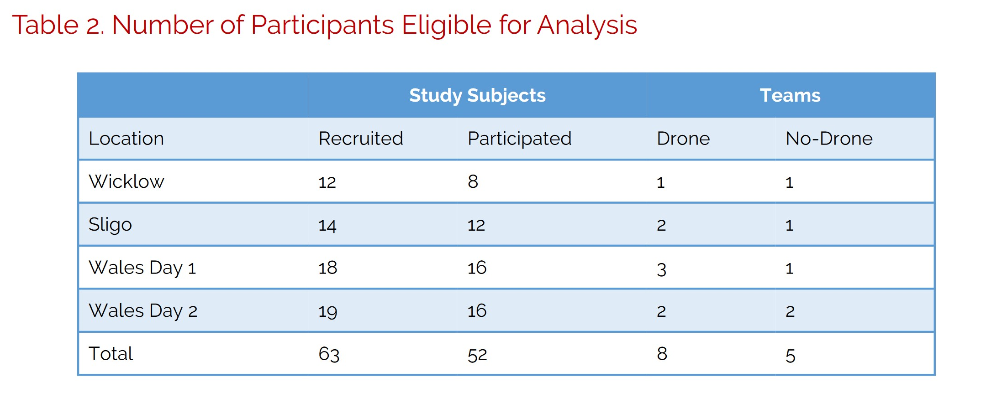
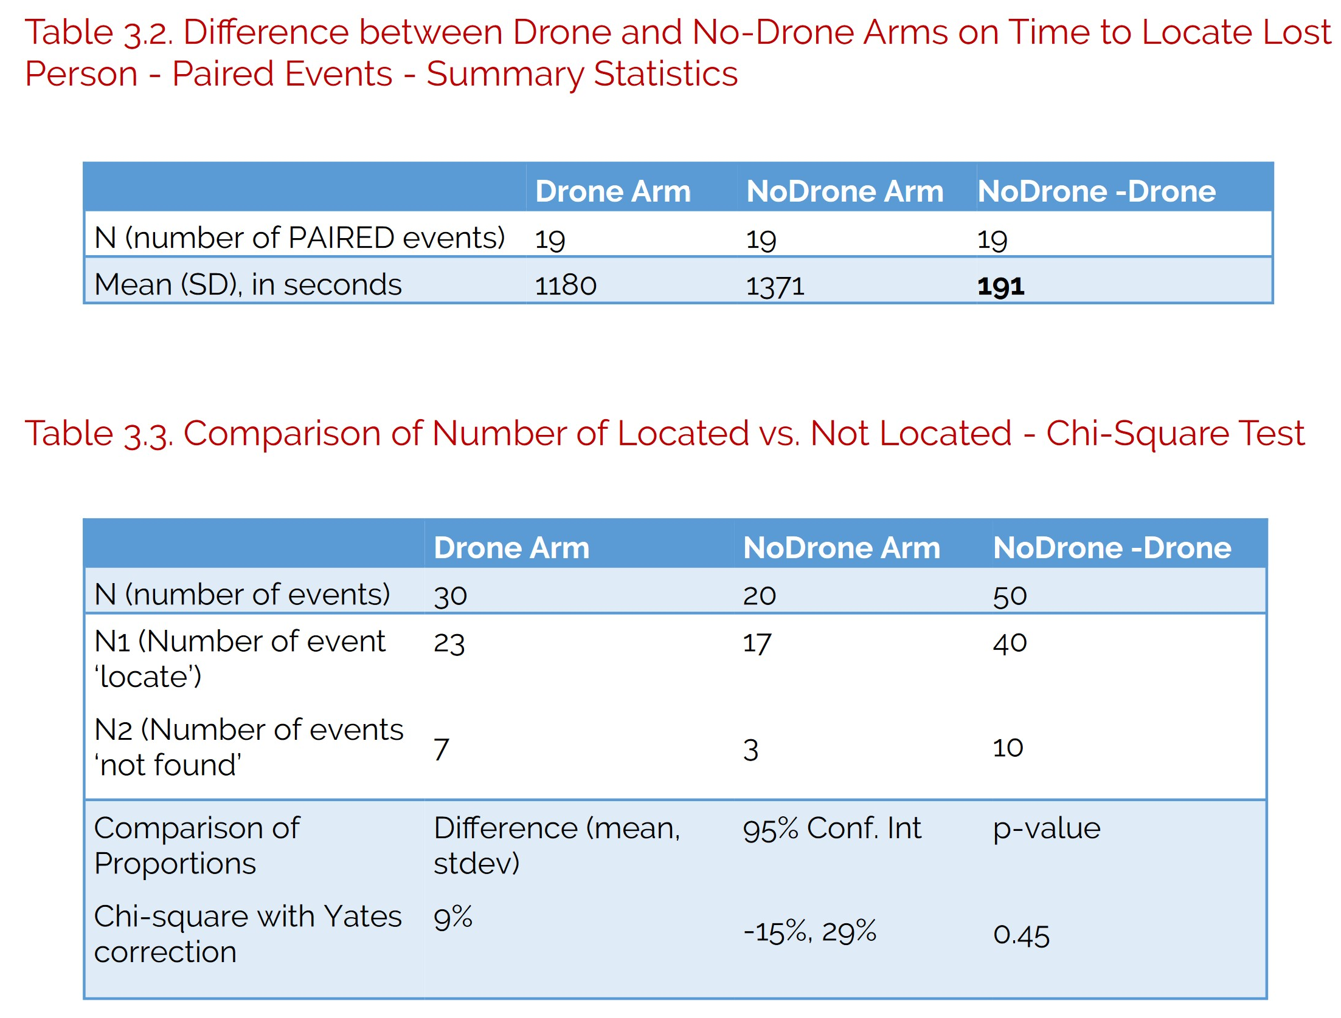
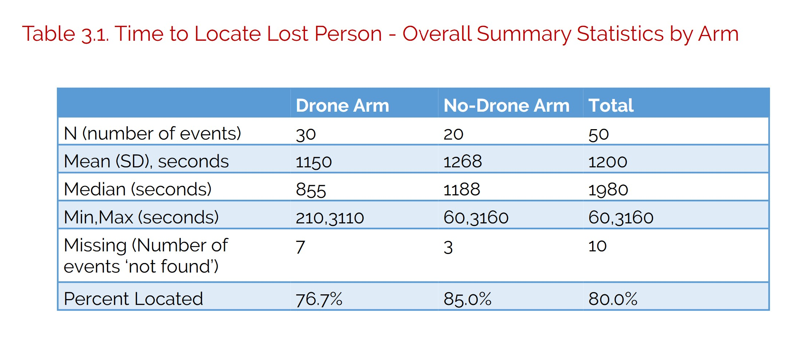
https://enterprise-insights.dji.com/en/en/learning-center/drone-efficacy-report-sar

Slide 14
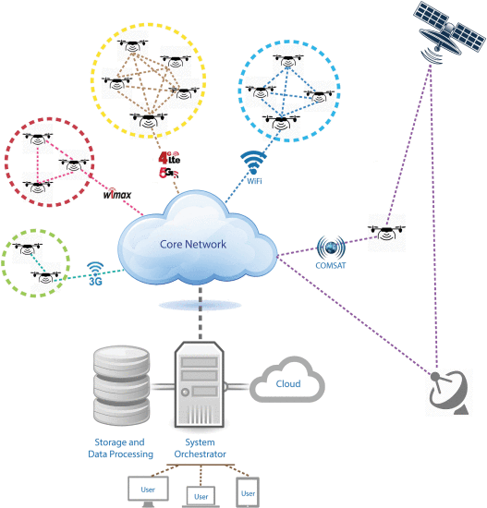
Related Work: Low-Altitude Unmanned Aerial Vehicles-Based IoT Services: Comprehensive Survey and Future Perspectives
Due to its ubiquitous usability, the UAV will play an important role in the Internet of Things (IoT) vision, and it may become the main key enabler of this vision.
Earthquake/Disaster Management Use Case
Crowd Surveillance
Real Time Monitoring of Road Traffic Conditions
https://ieeexplore.ieee.org/document/7572034

Slide 15
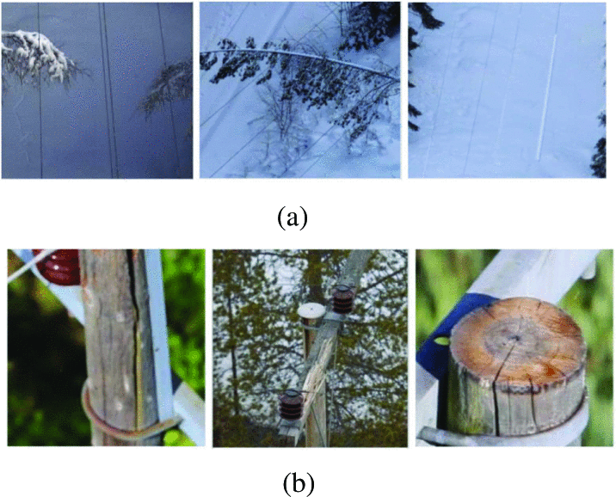
Related Work: Automatic Fault Detection of Power Lines using Unmanned Aerial Vehicle (UAV)
“Operational safety and automation are the two major challenges in the application of UAVs to the power lines inspection and fault detection. “
Using special Criteria, these drones need to be able to differentiate between different objects
Fault Detection related to Threat Detection
Three directly presented and tested solutions to account for better situational Awareness
Common faults on:(a) power lines (from left to right): trees growing too close to power lines, trees lying across power lines, icing on power lines. (b) power lines components (from left to right): broken poles, broken crossarms, missing toppads
https://ieeexplore.ieee.org/document/8658283

Slide 16
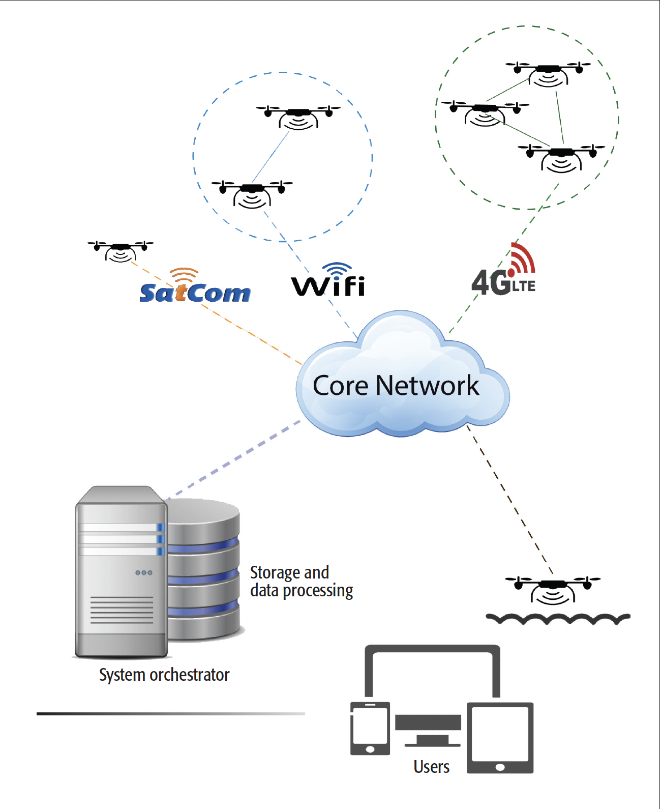
Related Work: PACED-5G: Predictive Autonomous Control using Edge for Drones over 5G
Explores Crowd-Surveillance as a Potential Use-Case for UAVs via Energy Consumption and Processing Time
Current UAV use cases are good but can always be improved
UAVs can be successfully integrated with IoT for MEC
https://ieeexplore.ieee.org/document/7842423

Slide 17
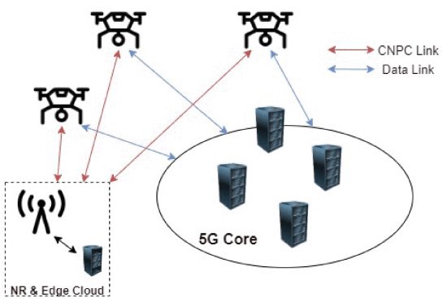
Related Work: Toward 5G Edge Computing for Enabling Autonomous Aerial Vehicles
Improving UAV capabilities promote interest in both commercial use as well as R&D
Easy deployment
High maneuverability
Range
Ability to carry payloads
Wholly on-board computing is not viable for long operations
Utilizing 5G connections to support Edge Computing with perimeter nodes
https://ieeexplore.ieee.org/document/10011219

Slide 18
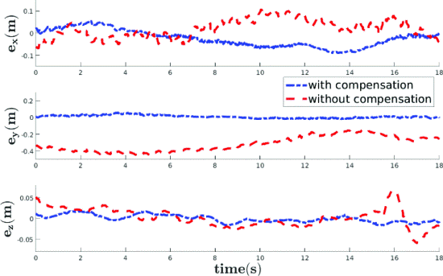
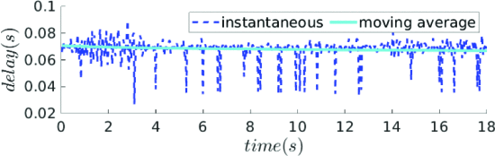
Related Work: PACED-5G: Predictive Autonomous Control using Edge for Drones over 5G
“Though technologies such as 5G networking minimize communication latency, the effects of latency on the control of UAVs are inevitable and may destabilize the system.”
Calculate X,Y, and Z vectors of the UAV ahead of time
Math-Heavy calculations, but the experiment and solution are easy to understand
https://ieeexplore.ieee.org/document/10156241

Slide 19
High level model design
Image Recognition Software
Integration
Camera/Sensor Array
Remote Control System (Manual & Automatic control)
Feedback to the User
SAR Target (Humans)
Communication & Storage Solution

Slide 20
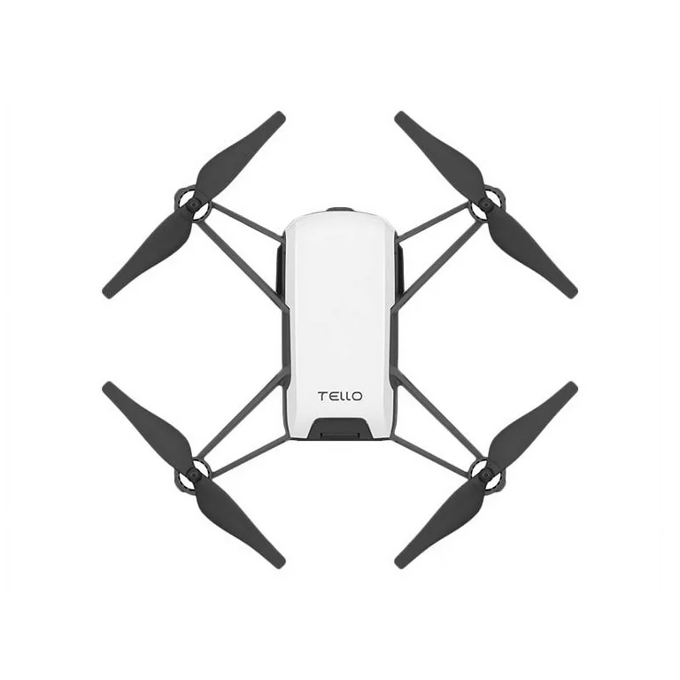
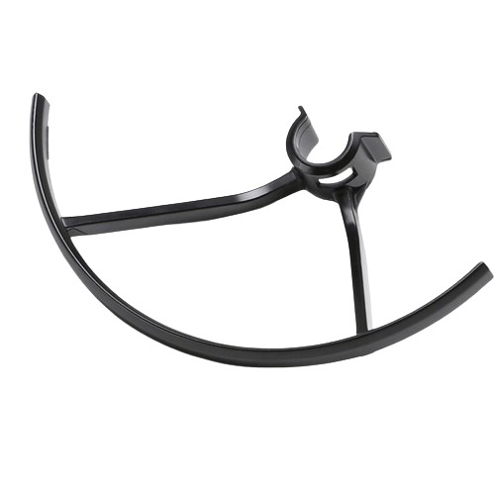


Implementation Pt.1: UAV-Based SAR Platform
The first part of our solution is the development of Threat warrior, a UAV-Based SAR system that features the following:
Integration of UAV and existing Search and Rescue technology (human detection & identification;)
UAV capability to either onboard or offload collected data
Notes:
First Bullet: This shall decrease the capital and operational expenses for creating a novel Ecosystem.
Second Bullet: The collected data can be processed locally onboard UAVs or offloaded to cloud servers on the ground (Think MEC)
Third Bullet: Benefit from sharing onboard IoT devices, computation resources, and data transmission links. In a cluster, a suitable UAV could be elected as the cluster head to transfer the collected IoT data on behalf of other UAVs to the ground station. Such a clustering approach may be beneficial in situations where UAVs do not have enough individual power/computation resources to accomplish a task or may need to complement each other’s IoT devices to carry out an IoT task.

Slide 21
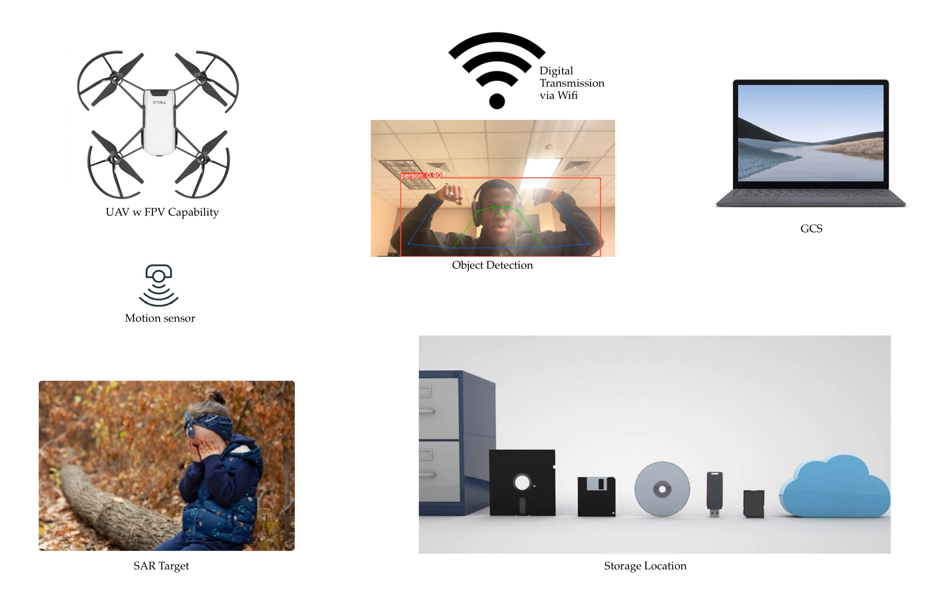
Implementation Pt. 2: Acquiring Footage in Flight
Threat Warrior does the following:
Observe what the UAV sees in real time (FPV)
Detect pre-specified SAR target (Humans)
Transport the collected data to the appropriate destination (Local storage)

Slide 22
Implementation Pt. 3: Data Processing
For the last implementation step, we figured that SAR operators might not always spot imagery from the drone, at the time the drone detects and identifies its target.
As such, our final contribution was to capture the tagged video that the drone sees for Local or Cloud-based data processing as the data is stored for SAR operators to reference.
Closer look at the data processing options:
Local: (Python Script)
Limited by on-hand storage
Virtually no cost
Cloud-based: (AWS)
Virtually unlimited storage
Can incur Immense cost

Slide 23
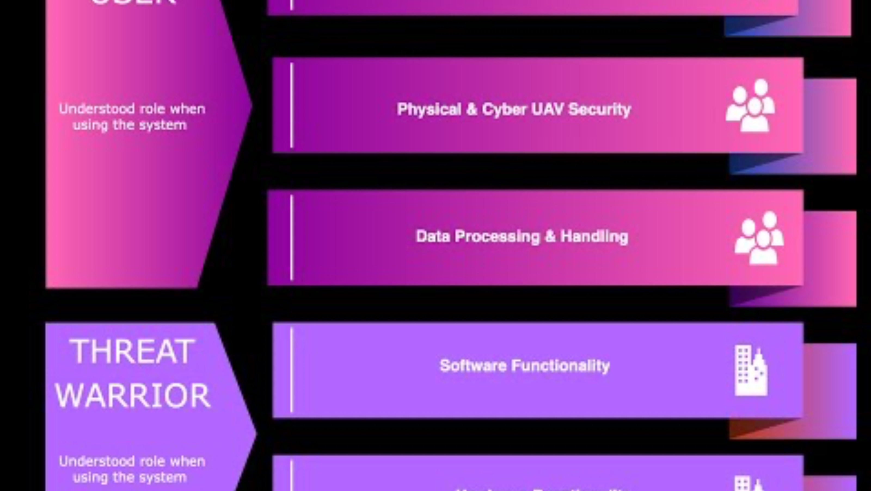
Threat warrior capability demo

Slide 24
Experiment: Initial Design
Hardware
M-series Mac (GCS)
DJI FPV (UAV) with digital transmission (O3)
DJI RC2 (Transmitter) & DJI Goggles v2 (VTX viewing device)
Software
Wide FPV
Amazon Rekognition
Procedures
Turn on and connect UAV to Transmitter and Goggles v2 to view the video
Connect Goggles v2 to GCS
Pair Goggles v2 to Wide FPV for video streaming
Share video stream with Amazon Rekognition for real-time object detection

Slide 25
Experiment: Failed Attempts & Lessons Learned
Hardware
MacOS vs Windows (M-series Macs have tons of compatibility issues at the hardware level)
Windows system or non-M-series Mac would have been a better fit for the experiment
DJI FPV drone was software locked and prevented development on the system
Turned to DJI Tello for open-source software with Python compatibility
Software
Wide FPV was unreliable
Developed code in Python to gain reliability
Amazon Rekognition wanted to incur immense cost
Went with a locally deployable solution instead

Slide 26
Experiment: Current Design
Hardware
M-series Mac (GCS)
DJI Tello (UAV) with 2.4Ghz digital transmission (Wi-Fi)
Software
Python code (OpenCV & YOLOv8 by Ultralytics)
Local Option (Preferred)
AWS & Amazon Rekognition
Cloud-Based Option
Procedures
Turn on and connect UAV to GCS via Wi-Fi (connect to Wi-Fi network generated by DJI Tello)
Run Python code for manual or autonomous flight (two respective codes)
Run flight pattern (divided by sector) or assume manual flight for SAR operation
Once motion is detected, tag object and run against ML algorithm and confidence interval
One automated sector is complete or with manual input, UAV lands and generates video file for SAR operator reference
Can also run this experiment in AWS environment and let Amazon Rekognition process video stream

Slide 27
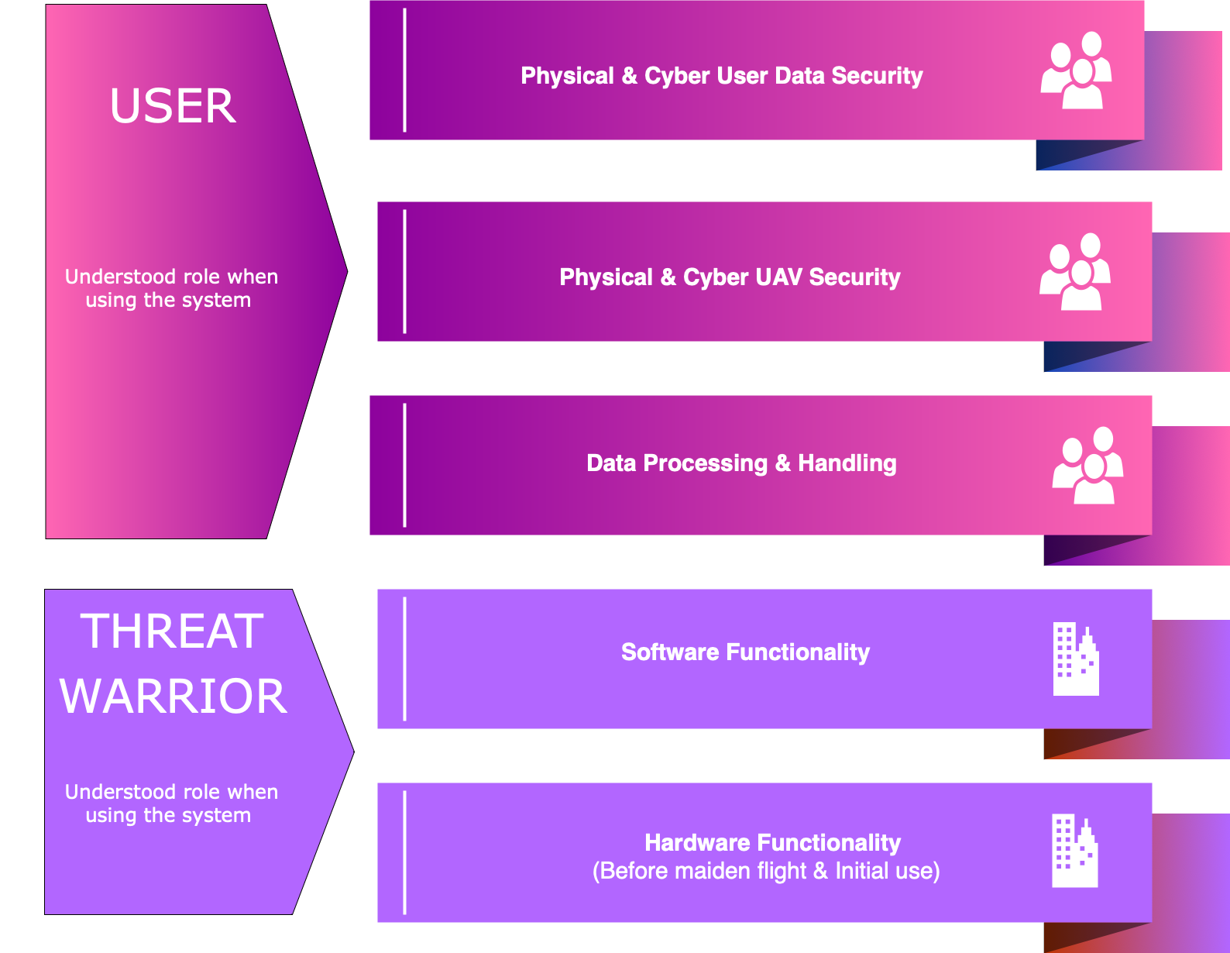
Shared Responsibility Model

Slide 28
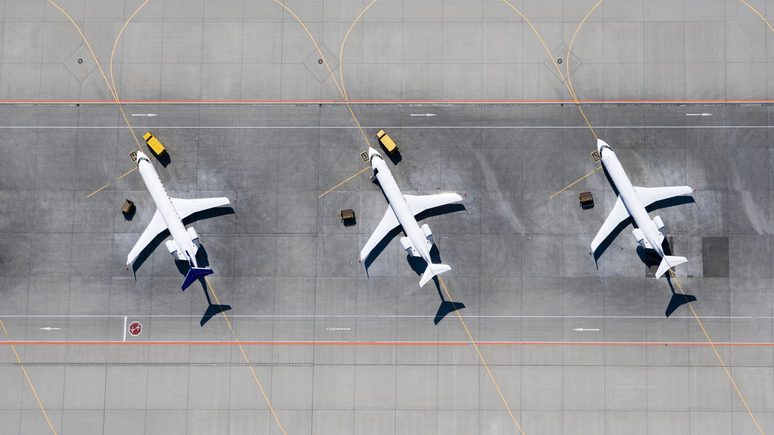

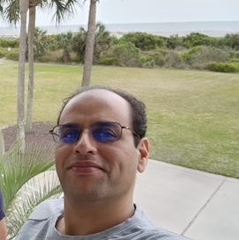
Experiment: Example Scenario
Dr. Azab went hiking in Lexington with two students, but tripped and fell and is bleeding out. The students left to seek help, managed to find SAR operators, but lost Dr. Azab. However, the SAR operators recently implemented our Threat Warrior system. Will Dr. Azab be found before it is too late?

Slide 29

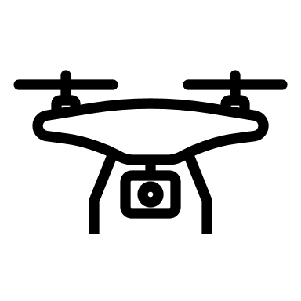






Experiment: Example Scenario Explained

Slide 30
Cost Breakdown
30/32
Traditional Human Approach
UAV-supported Approach
Average SAR Salary $40-80K/year
Cost to equip $10-15k once
Initial Cost of Training up to $22k
Annual Continuing Education $2-5k/year
Drone Operator Salary $70-120k/year
Purpose-built Drone $5-20k
Private Pilot’s License $10k
Commercial Pilot’s License $50-100k
FAA Part 107 and Related Regulatory

Slide 31

Evaluation
In our paper, we consider UAV-assisted SAR use cases and investigate the benefits (and drawbacks) of our proposed solution.
First Responders are slow to adapt and hesitant to open their wallets
Upon research and initial implementation, it is evident that drones are viable solutions to both the persistent cost and speed problem
However, there is still room for improvement and further research in the area
We came to this conclusion by comparing the performance of individual searchers vs. drones

Slide 32
Conclusion and Future Direction
In summary, our solution addresses the current challenges that plague SAR missions and improves upon the current use cases of UAVs
Finalize paper to garner funding and support for UAVs in SAR operations
Expand upon research to develop standalone drone with more sensors to best facilitate SAR operations
Future Direction

